Slide 1
BBQ Cook’s Meeting
Aug 17, 2022
2022 Family Gathering

Slide 2
Agenda
What are We Cooking?
Meat Pickup
Smoker Transportation
Cook Site Setup
Food Safety
Time Management
Cooks Breakfast
Competition
Entertainment
Tear Down and Clean Up

Slide 3
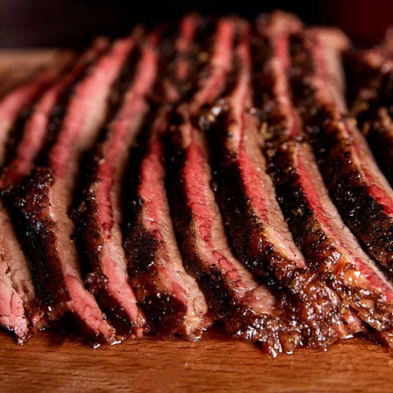
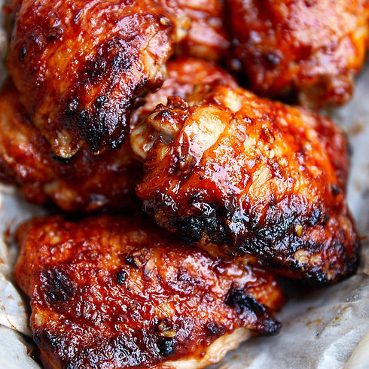
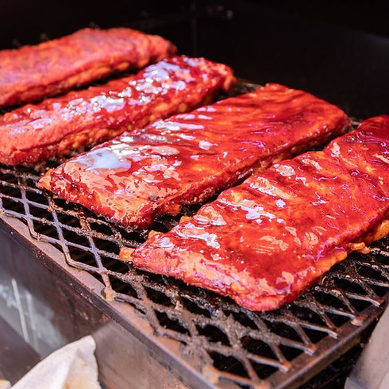
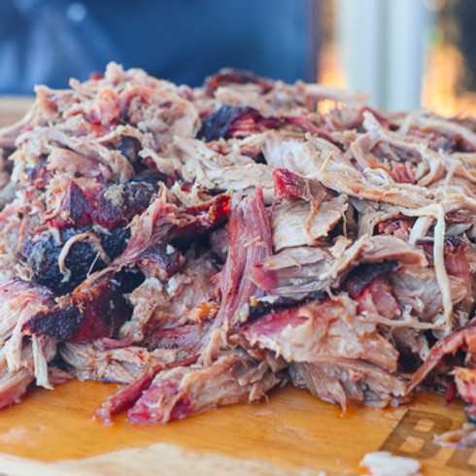
What Are We Cooking?
Sliced Brisket
Chicken Thighs
Pork Spare Ribs
Pulled Pork

Slide 4
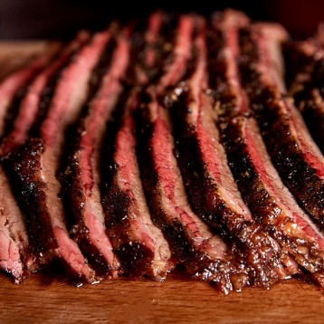
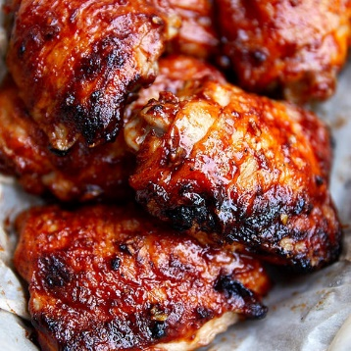
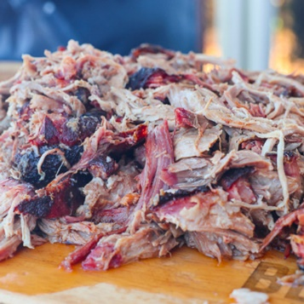
What Are We Cooking?
Expecting to Feed About 500 Guests
(572 Pounds of Food)
13 Briskets
156 Pounds
Avg 1 brisket per cook
500 Chicken thighs
156 Pounds
36 thighs per cook
42 Slabs of ribs
104 Pounds
Avg 3 slabs per cook
23 Pork Butts
156 Pounds
Avg 1.6 pork butts per cook

Slide 5
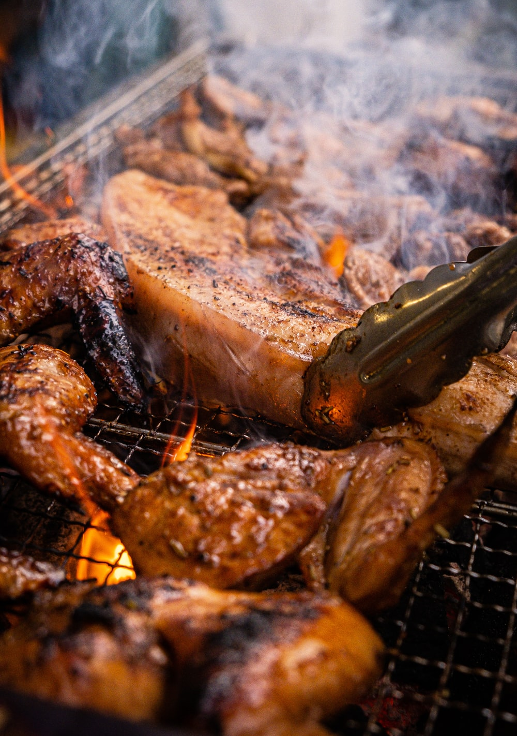
What Are We Cooking?
Average Food Per Cook
1 Brisket
1 to 2 Pork Butts
3 to 4 Slabs of Ribs
35 to 40 Chicken Thighs

Slide 6
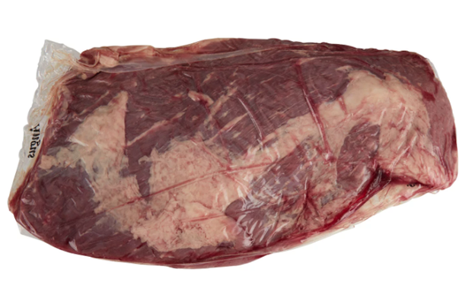
Meat Pickup
Friday – Aug 26
6pm to 8pm
Antioch Campus (kitchen in basement)
Bring coolers with you to pickup

Slide 7
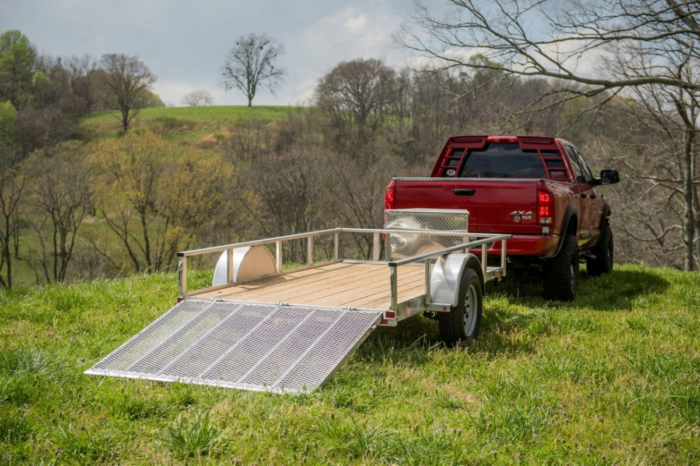
Smoker Transportation
Need Some Help Moving Your Smoker?
Free transportation to and from church
2 Trailers available
Sign-up sheet

Slide 8
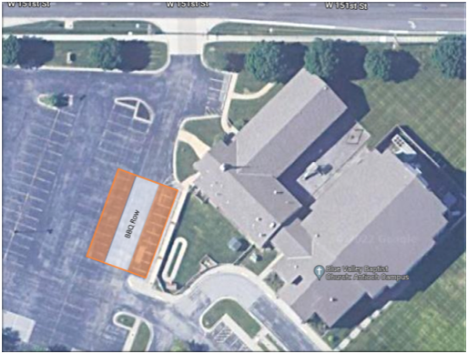
Cook Site Setup
New Location This Year!
Setup begins at 6pm on Saturday Aug 27
Security guards will be on site from 6pm until the 1st cook arrives
Cooking locations will be numbered and assigned based on need for power, trailer parking, etc
You will receive your cooking location when you pick up the meat

Slide 9
Cook Site Setup
What the Church is Providing
All the meat
8-foot folding table per cook station
2 folding chairs per cook station
Foil pans, aluminum foil, sharpies
Anti-bacterial wipes
Food safe gloves
Trash cans and trash bags
Power (as requested)
Clam shell containers for competition turn-ins
Cold water bottles for the cooks
Access to the basement kitchen

Slide 10
Cook Site Setup
What You Need to Provide
Smoker
Charcoal, pellets or other wood fuel
Seasonings for the meat
Sauce for the meat
Cooking utensils
Canopy (optional)
Comfortable chair (optional)

Slide 11
Food Safety
Clean – wash hands and surfaces often
Separate – Don’t cross-contaminate
Cook – Cook to proper temperatures
Chill – Refrigerate promptly

Slide 12
Time Management
Plan Your Cook!
Cooking Time
Brisket (9+ hours)
4:00PM
Pork (9+ hours)
3:30PM
Ribs (5+ hours)
3:00PM
Chicken (2+ hours)
2:30 PM
Sample cook schedule available for download at bluevalleybbq.com

Slide 13
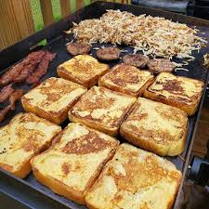
Cook’s Breakfast
Free Breakfast!
Starts at 8am
Coffee, orange juice, water
Egg casserole
Pancakes
Sausage
Fruit salad
Coffee cake

Slide 14
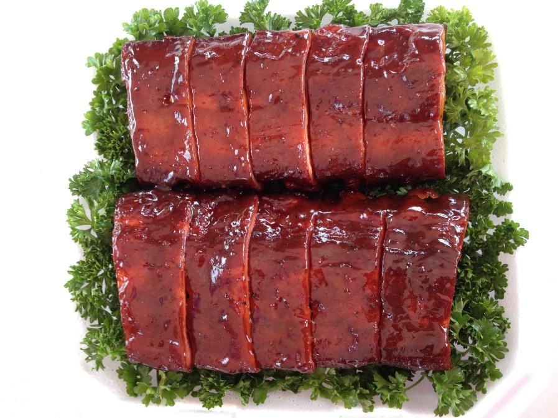
Competition
Basic Rules
4 Meat categories (chicken, ribs, pork, brisket)
Each submission must be turned in separately in the provided 9x9 clamshell container
Each submission will be scored by 6 judges
Minimum of 6 portions per container
Each submission will be anonymous (assigned a unique ID number instead of a name)

Slide 15
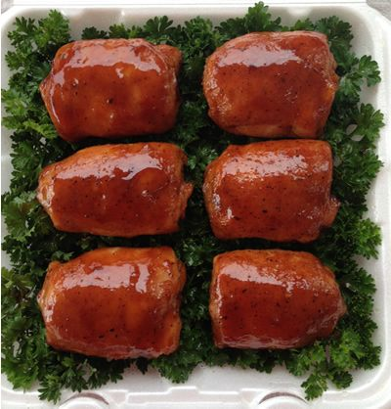
Competition
Scoring
Each submission will be judged on 3 factors: taste, tenderness and appearance
Each factor will be assigned a score from 1 to 9 with 9 being the highest
Each factor will be weighted equally
The cook with the highest points from all 6 judges will be determined the winner of that category
The cook with the highest points from all categories will be determined to be the Grand Champion
Perfect score from 1 judge = 27 (9 x 3)
Perfect score from all 6 judges = 162 (27 x 6)

Slide 16
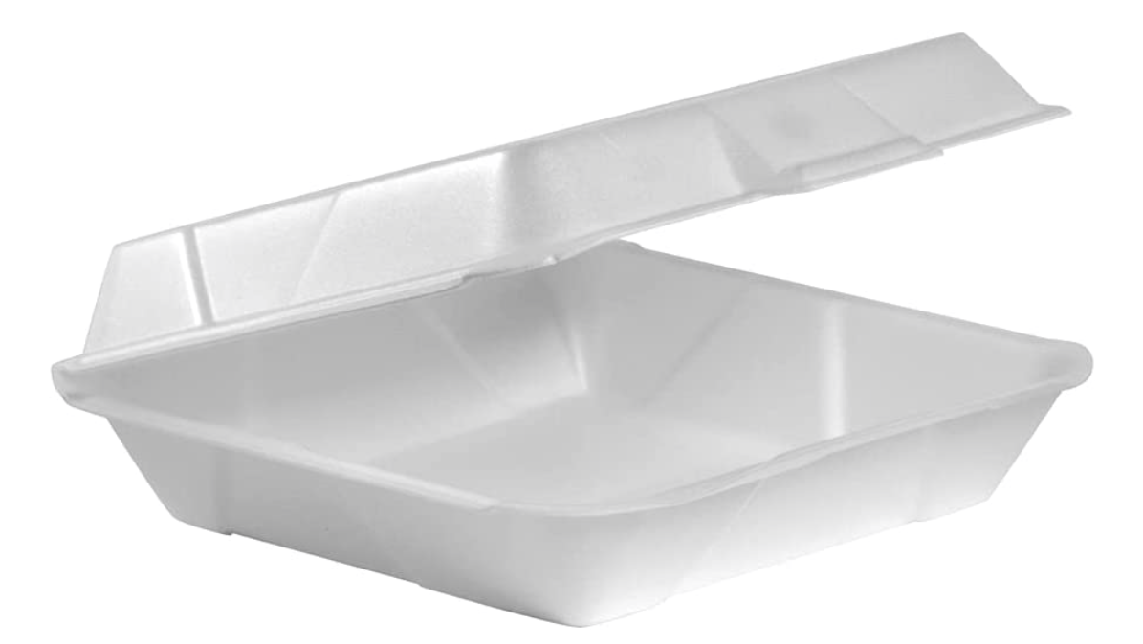
Competition
Turn In Container
9” x 9” x 3.5” Styrofoam Clamshell

Slide 17
Competition
Turn In Times
All entries must be submitted at the turn-in table located in Fellowship Hall based on the following schedule:
2:30pm - Chicken
3:00pm - Ribs
3:30pm - Pork
4:00pm - Brisket

Slide 18
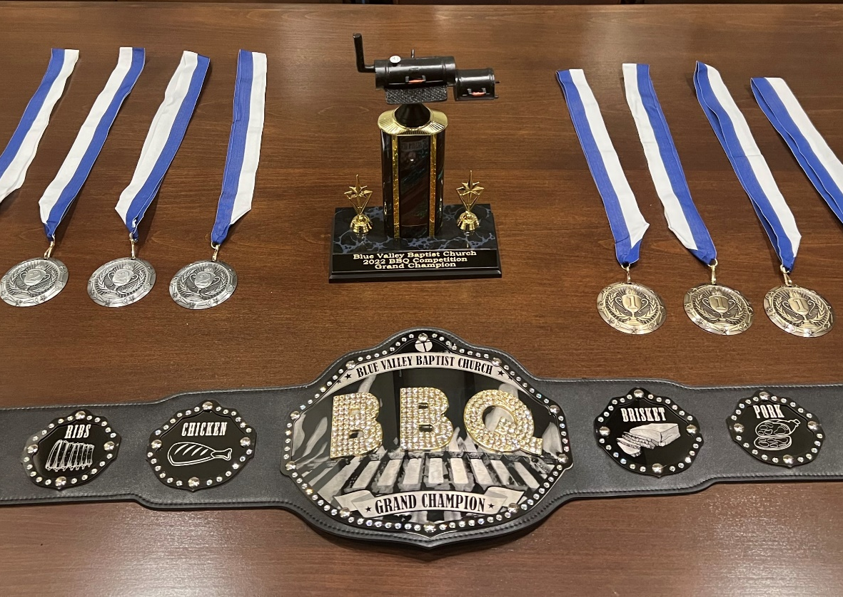
Competition
Awards
1st and 2nd place medals will be awarded to each meat category
The grand champion will receive the following awards:
Trophy (which you get to keep)
Traveling Grand Champion belt (which transfers to the new winner each year)
Name engraved on a plaque with other Grand Champion winners

Slide 19
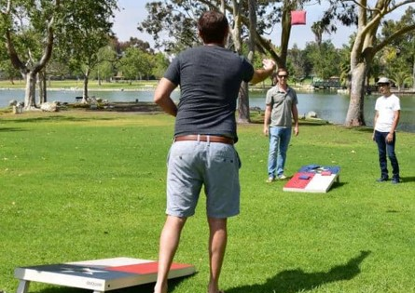
Entertainment
Let’s Have Some Fun!
Music
Hourly trivia questions – winner controls the music playlist
Cornhole
Card / Game Table

Slide 20
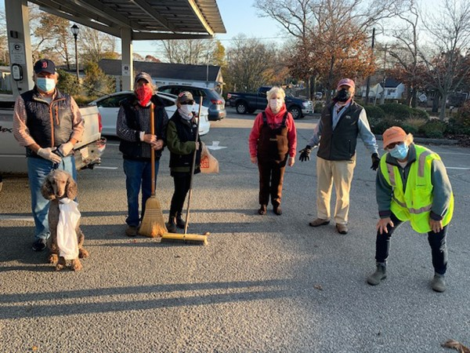
Tear Down and Clean Up
Leave It Better Than You Found It!
Smokers should be removed as soon as the family gathering is winding down
Remove all trash and debris from your area
Help your neighbor
Tear down and clean up must be completed by 9pm on Sunday

Slide 21
?
Do you have any questions?
?
?

